Slide 1
EVENT-BASED DATA ASSURANCE
WORKSHOP #6: RULES OF ENGAGEMENT (1)
11th March 2020

Slide 2
Agenda
Introductions 14.00 – 14.10
Recap of key points from Workshop #5 14.10 – 14.30
Discussion – OEF rules of engagement 14.30 – 16.00
Target use case – importing wine into the UK 16.00 – 16.45
Questions / any other business 16.45 – 17.00

Slide 3
Section 1
Recap from Workshop #5

Slide 4
Workshop schedule
W/s | Date | Deliverable | Agenda | Attendees
KO | 29/01 1-4pm | Common understanding | Questions Problem statements Expressions of interest | FB Technical Architect HMRC Technical Architect HMRC Innovation Lead
#1 | 05/02 1-4pm | Standards | Standards to implement and communicate shared knowledge base used in event-based data assurance
#2 | 12/02 1-4pm | Metadata model | Reasoning models for data assurance Classification Events Chains / sequences / methods Actors (e.g. source of events) Relationships (e.g. linking IDs) Supporting metadata Schema / headers Mandatory Optional
#3 | 19/02 1-4pm
#4 | 26/02 2-5pm
#5 | 04/03 1-4pm | Expert input | Expert assessment of proposed standards and metadata model | Representatives of Inrupt, Oxford Semantic Tech
#6 | 11/03 1-4pm | Rules of engagement | Boundary of open alliance Scalable / mutual contractual agreements for value exchange Value exchange mechanisms Publication of / subscription to events Permissioning (including consent) Use of standards and metadata model Governance | HMRC Innovation Lead HMRC Stakeholders x2 GDS representative(s)
#7 | 18/03 1-4pm
#8 | 25/03 9am-12

Slide 5
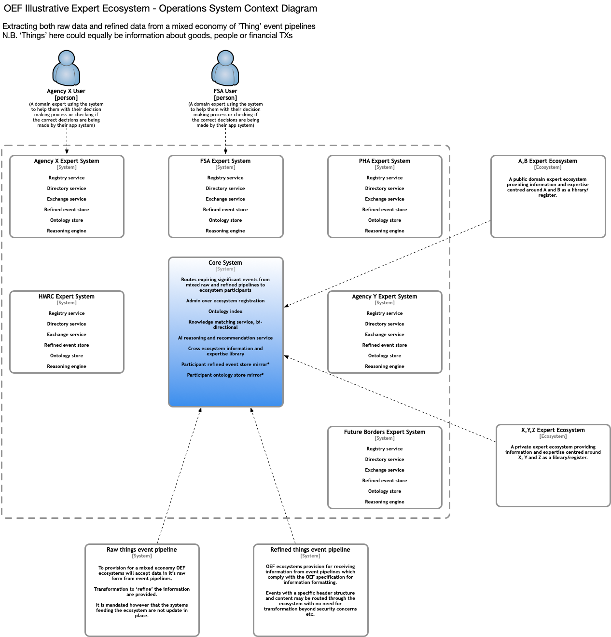
Illustrative Ecosystem Level [n] System Context Diagram

Slide 6
Responsibilities that MUST be represented in OEF ecosystems
Entry Point Service: at least one addressable API that provides access to the ecosystem
Refinery Service: to transform ‘raw’ data from external systems into OEF events
Event Pipeline: an external system generating data to be refined as events in the ecosystem
Event Store: a store for the refined events posted into the ecosystem by a participant
Registry Service: a record of ecosystem participants and their authorised scope of action
Directory Service: to facilitate discovery and matching between ecosystem participants
Exchange Service: to support information flow and value exchange between participants
Administration Service: to maintain shard artefacts critical to the operation of the ecosystem
Ontologies: conceptual models of the domain of interest shared by the ecosystem
Reasoning Engines: to derive insight and extract value from events in the ecosystem

Slide 7
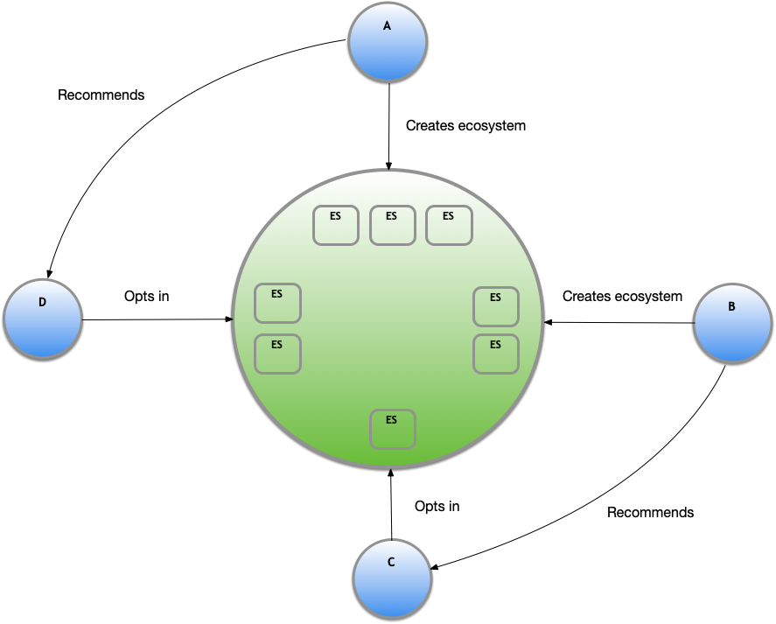
Tracing the genesis of an OEF ecosystem

Slide 8
Section 2
OEF rules of engagement

Slide 9
Rules of engagement Incoming hypotheses
“Rules of engagement” establish a basic behavioural framework that:
Requires participants to shoulder a minimum set of responsibilities through the implementation of technical specifications
Extends beyond technical specifications where necessary, but does not raise any unnecessary barriers to entry into the ecosystem
The Discovery Project set out some dimensions to be explored
Boundary of open alliance
Scalable / mutual contractual agreements for value exchange
Value exchange mechanisms
Publication of / subscription to events
Permissioning (including consent)
Use of standards and metadata model
Governance

Slide 10
What is an OEF ecosystem trying to achieve? Incoming hypothesis
To minimise the friction involved in sharing expertise between collaborating parties
To reduce the effort and cost of administration over highly shared information
To de-duplicate information storage and inference over it (where appropriate)

Slide 11

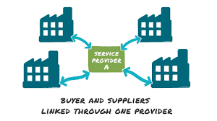
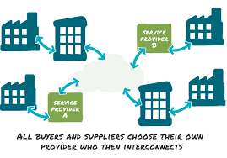
What are the alternatives? Illustrative example: models of e-invoicing*
2 corner model
3 corner model
4 corner model
Peer-to-peer process where the supplier and buyer directly share documents using EDI / XML files
Supplier/buyer use the same third party service provider to process e-documents between them
Supplier/buyer use different service providers, who then collaborate with each other to process e-documents
* Source: cloudtradenetwork.com

Slide 12
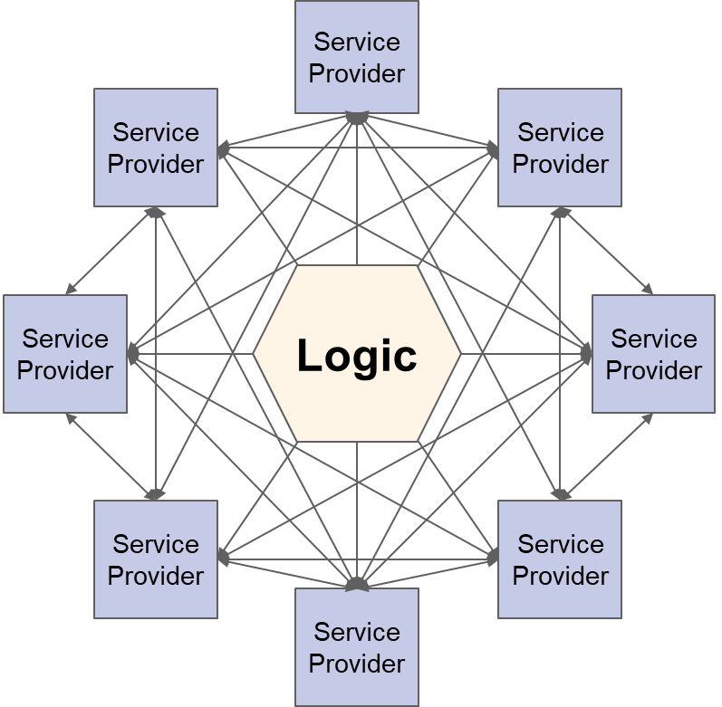
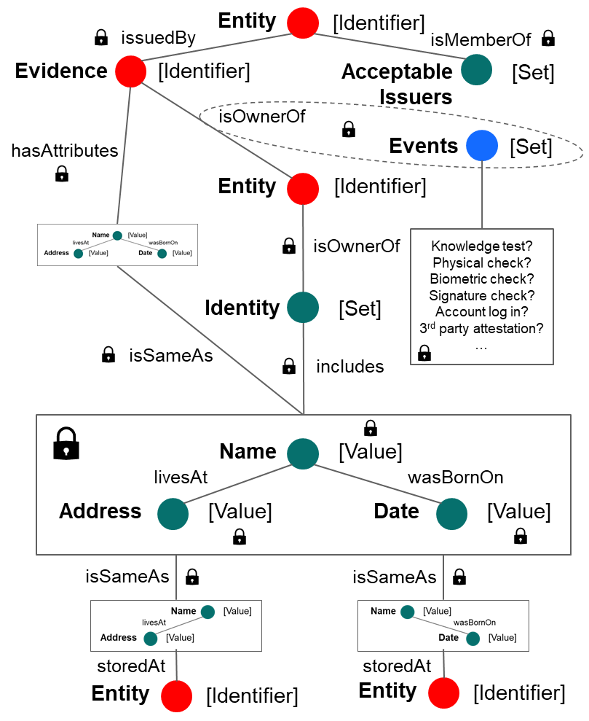
As an ecosystem, we will…: Create a consistent, meaningful and accessible metadata layer
Participant
Expert System
Participant
Participant
Expert System
Expert System
Participant
Expert System
Events
Expert System
Participant
Expert System
Expert System
Expert System
Participant
Participant
Participant

Slide 13
As an ecosystem, we will…: Express key concepts in a consistent, machine readable way
“I have already collated/validated/processed this information about this thing”
Or
“I am in a position to collate/validate/process this information about this thing”
And
“Here is what I mean by collate/validate/process”
“Here is what I mean by this information”
“Here is what I mean by this thing”
And
“This is what you need to do to acquire the attributes that authorise you to read/write/append/control this information about this thing”
“This is what I mean by read/write/append/control – i.e. terms of authorised access”
And
“Here is how we agree to track what happens next”
“Here is what happens if you breach the terms of authorised access”

Slide 14
As an ecosystem, we will…: Express key concepts in a consistent, machine readable way
“I have already collated/validated/processed this information about this thing”
Or
“I am in a position to collate/validate/process this information about this thing”
And
“Here is what I mean by collate/validate/process”
“Here is what I mean by this information”
“Here is what I mean by this thing”
And
“This is what you need to do to acquire the attributes that authorise you to read/write/append/control this information about this thing”
“This is what I mean by read/write/append/control – i.e. terms of authorised access”
And
“Here is how we agree to track what happens next”
“Here is what happens if you breach the terms of authorised access”
Directory

Slide 15
As an ecosystem, we will…: Express key concepts in a consistent, machine readable way
“I have already collated/validated/processed this information about this thing”
Or
“I am in a position to collate/validate/process this information about this thing”
And
“Here is what I mean by collate/validate/process”
“Here is what I mean by this information”
“Here is what I mean by this thing”
And
“This is what you need to do to acquire the attributes that authorise you to read/write/append/control this information about this thing”
“This is what I mean by read/write/append/control – i.e. terms of authorised access”
And
“Here is how we agree to track what happens next”
“Here is what happens if you breach the terms of authorised access”
Ontology (declarative)

Slide 16
As an ecosystem, we will…: Express key concepts in a consistent, machine readable way
“I have already collated/validated/processed this information about this thing”
Or
“I am in a position to collate/validate/process this information about this thing”
And
“Here is what I mean by collate/validate/process”
“Here is what I mean by this information”
“Here is what I mean by this thing”
And
“This is what you need to do to acquire the attributes that authorise you to read/write/append/control this information about this thing”
“This is what I mean by read/write/append/control – i.e. terms of authorised access”
And
“Here is how we agree to track what happens next”
“Here is what happens if you breach the terms of authorised access”
Ontology (instructive)

Slide 17
As an ecosystem, we will…: Express key concepts in a consistent, machine readable way
“I have already collated/validated/processed this information about this thing”
Or
“I am in a position to collate/validate/process this information about this thing”
And
“Here is what I mean by collate/validate/process”
“Here is what I mean by this information”
“Here is what I mean by this thing”
And
“This is what you need to do to acquire the attributes that authorise you to read/write/append/control this information about this thing”
“This is what I mean by read/write/append/control – i.e. terms of authorised access”
And
“Here is how we agree to track what happens next”
“Here is what happens if you breach the terms of authorised access”
Rules of Engagement?

Slide 18
As an ecosystem, we will…: Use a consistent syntax; treat all Events as logically the same
Header
Used
Claimant
Customer
Bank employee
Manager
Supervisor
Advisor
Trainee
Third party
Agent
Lawyer
Accountant
Doctor
Web-browser app
In branch system
Paper and pen
To assert that
claimsToHave
isInPossessionOf
isTheOwnerOf
UK Passport
UK / EU Driver’s Licence
EU National ID Card
Student Union Card
Employee Pass
Rail Photocard
Body

Slide 19
As an ecosystem, we will…: Share vocabularies to make more Events relevant to each other
Example: events to check evidence belongs to a Claimant
Verb | Definition
hasIssuedKnowledgeBasedChallenge | The Actor has issued a Knowledge Based challenge to verify a Claimant's relationship with evidence
hasPassedKnowledgeBasedChallenge | The Actor (e.g. claimant) has responded successfully to a Knowledge Based challenge
hasFailedKnowledgeBasedChallenge | The Actor (e.g. claimant) has responded unsuccessfully to a Knowledge Based challenge
hasSentActivationCode | The Actor has sent an activation code to the claimed identity (e.g. debit card]
hasRespondedActivationCode | The Actor (e.g. claimant) has responded successfully and used the activation code
checkedPhysiologyEvidence | The Actor checked that the Claimant's appearance was consistent with Evidence Attribute Profile (e.g. sex, age)
checkedFacePhotoInPerson | The Actor checked the face of the Claimant in person, to compare to photo image from evidence
checkedFacePhotoRemote | The Actor checked the face of the Claimant remotely (e.g. video link), to compare to photo image from evidence
checkedBiometricsPhysical | The Actor checked that Claimant's biometrics matched those contained in the Evidence, using physical tools
checkedBiometricsDigital | The Actor checked that Claimant's biometrics matched those contained in the Evidence, using digital technology
Illustration: overlapping semantic references
Banks
Telcos
Utilities

Slide 20
As an ecosystem, we will…: Store (and explicitly manage) Events separately from attributes
End Users
End users engage with applications
Applications host end user attributes
Distributed metadata service provision
A shared – or shareable – metadata layer
…contracts with…
…contracts with…
App
...exchanges data with…
App
…contracts with…
…contracts with…
Metadata Service Provider
...communicates with…
Metadata Service Provider
…complies with…
…complies with…
Syntax

Slide 21


As an ecosystem, we will…: Avoid the need to rely on a single technology / point of failure
Providers of information
Providers of information
1
2
N
1
2
N
1
2
M
1
2
M
Consumers of information
Consumers of information

Slide 22

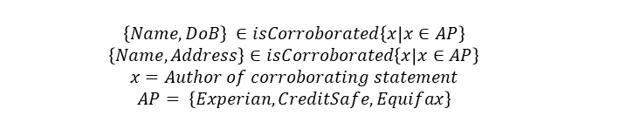
As an Event Consumer, I will…: Specify my requirements as a machine readable template
Description: Natural Language | Description: Structured Language | Execution: code
Human Readable | Human and Machine Readable | Machine Readable
Illustrative: JMLSG Guidelines | Required data set | Matching engines
Electronic ID&V
The standard level of confirmation, in circumstances that do not give rise to concern or uncertainty, is:
One match on an individual’s full name and current address, and
A second match on an individual’s full name and either her/his current address or his date of birth
Name
Address
DoB
Required Assurance Level
$$\left\{Name, DoB\right\} ∈isCorroborated\left\{x | x∈AP\right\}$$
$$\left\{Name,Address\right\}∈isCorroborated\left\{x | x∈AP\right\}$$
$$x=Author of corroborating statement$$
$$AP= \left\{Experian, CreditSafe, Equifax\right\}$$

Slide 23
As an Event Consumer, I will…: Use reasoning to combine Events, assert status and place trust
Illustrative example: ID&V
If…
JMLSG Guidelines for the standard Identification and Verification (ID&V) of a private individual:
Identification: record full name, date of birth and residential address of the individual
Verification: obtain documentary or electronic evidence from reliable sources, independent of the individual
Standard workflow: verification against document with a photo (e.g. passport) and recent document with address (e.g. utility bill)
Claimant is present in branch
Conditions precedent have been met
If…
...and...
Claimant is in possession of passport
…then…
...and...
Claimant is in possession of utility bill
...and...
Bank staff matches photo to Claimant to confirm ownership
Successful passport check has been completed
If…
...and...
…then…
Bank staff checks date to confirm Passport is valid
...and...
Bank staff checks watermarks to confirm Passport is authentic
...and...
Bank staff checks utility bill to confirm it is authentic
Successful utility bill check has been completed
If…
...and...
…then…
Bank staff checks date to confirm it is recent (within 3 months)
...and...
Bank staff checks name to correlate with Passport
...then...
ID&V successful
Events
Rules

Slide 24
As an Event Consumer, I am able to…: Develop different reasoning models, and to publish outcomes
Authority | I know that Ben is Ben, because a trusted authority (e.g. an authorised identity provider) tells me that he is
Authorship | I know that Ben has a utility account with Eon, because Eon (i.e. the author of his account) has told me that Ben has an account
Consensus | I know that Ben owns this financial asset because Parties A, B, C and D all agree that he does
Correlation | I know that Ben lives at 30 Acacia Avenue because his wife is registered as living at 30 Acacia Avenue
Attestation | I know that this photo is a true likeness of Ben because two independent witnesses have signed and attested it to be as such
Usage | I know that Ben’s mobile phone number is 07777 123456 because it has been used to respond successfully to several OTP checks
Inference | I know that Ben is over 16 years old because he has grey hair, a beard, bi-focal glasses, wrinkles and a stooped gait

Slide 25
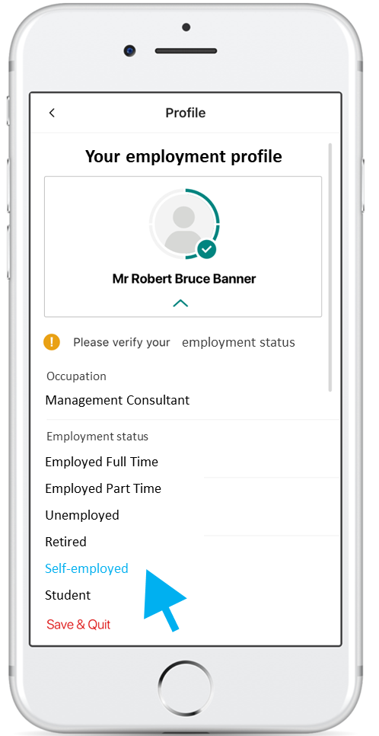
As an Event Producer, I am able to…: Offer customers a valuable new service to manage their data
Example data management functionality
Manage authorisations and consents
For use within an institution
For use externally
Customer access to:
A history of communications
A history of activity
Notification of:
Request for outstanding action
Confirmation of completed action
View and manage Available Profile:
Add
Confirm
Amend
Delete
View and manage evidence package:
Take photo / selfie
Upload document
Authorise access to data from another account

Slide 26
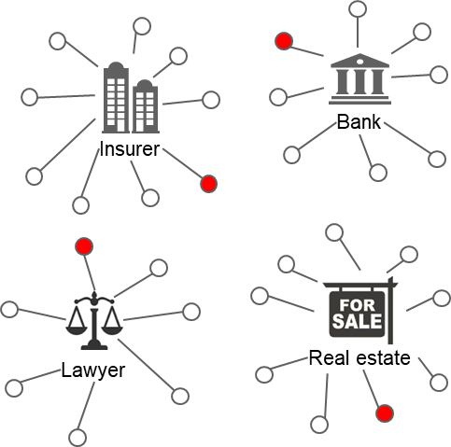
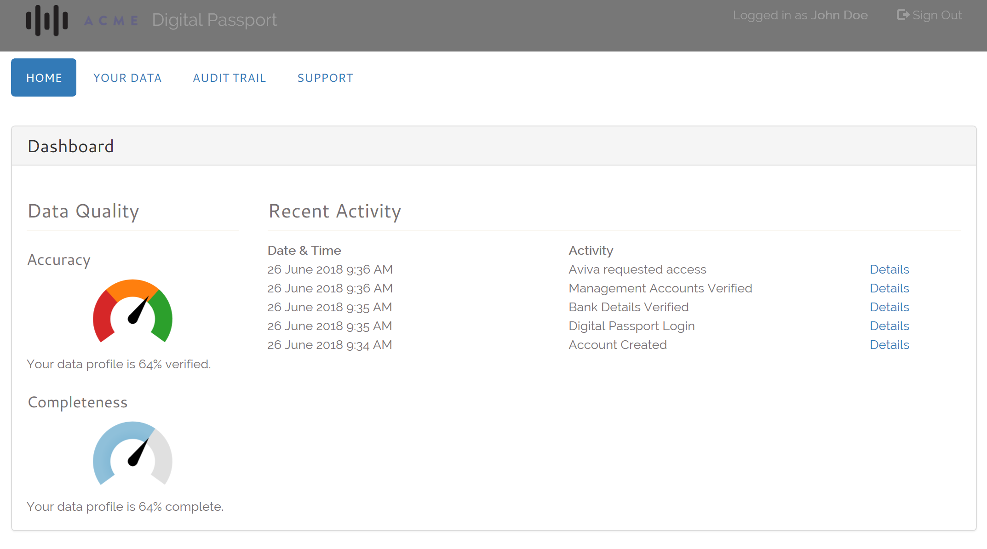
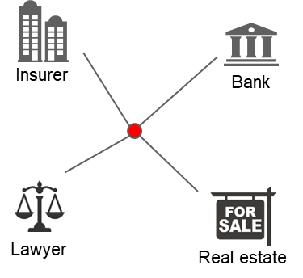
As an Ecosystem Participant, I am able to…: Give my customers tools to manage Events relating to them
User control
Audit trail
Distributed data storage
Trust scores (e.g. from Service Providers)

Slide 27
As a (trusted) Expert System (service), I am able to…: Earn a return on effort to store and manage access to Events
4-corner model
Directory: allows participants to publish the availability of data and services, and for other users to discover and consume them
Relationship mapping: enables participants to assert linkages between attributes and entities; map is amenable to graph theory
Event Store: captures a complete and immutable audit trail of activity that is vital to compliance, assurance and governance
Permissioning: manages authorisations at a field level; handles complex B2B situations; offers data owners a single point of control
Value-added services: including e.g. template access requests, asynchronous routing, attestation / comments, watch / notification services, pricing of resources, etc.
Parti-cipant A
...exchanges with…
Parti-cipant B
…contracts with…
…contracts with…
Expert System
C
...communicates with…
Expert System
D
…complies with…
…complies with…
Syntax

Slide 28
Section 3
Target use case

Slide 29
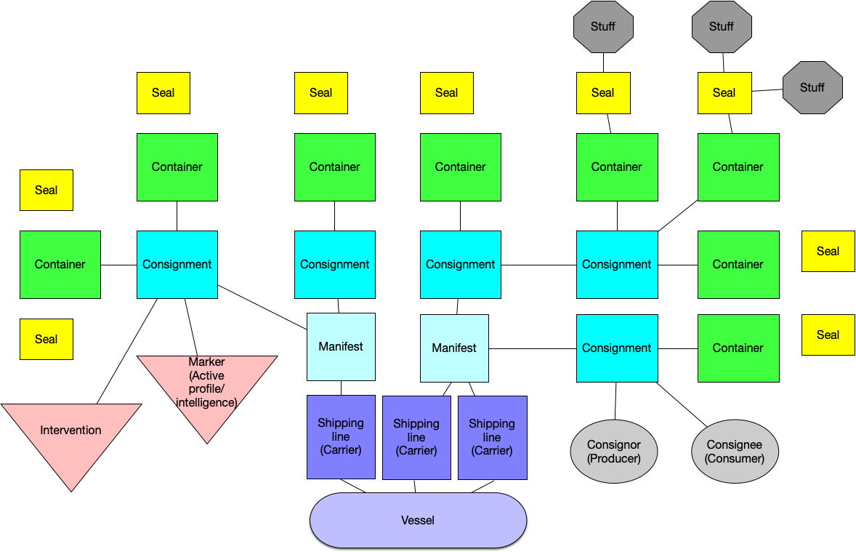
Domain knowledge – configuration of a ship

Slide 30
Domain knowledge – Event types
Use case specific events
Generalised events
Does the consignment originate from the country which it states it does?
Does the consignment contain what is stated on the manifest?
Does the freight forwarder/trader/importer/carrier have a history of (not) being stopped?
Does this freight forwarder / trader / importer / carrier have a history of imports which were "good“?
Has this freight forwarder / trader / importer / carrier been seen before?
Is this freight forwarder / trader / importer / carrier behaving in a way which is unusual?
How is this freight forwarder / trader / importer / carrier linked to others?
What has happened to this thing / person?
Is this thing / person the subject of this information set?
Does this information set represent this thing / person?
What is the source of this information set?
What is the relationship between this thing and that thing?
Is this the same thing as that thing?
What is the status of this thing?

Slide 31
Section 5
Q&A / AOB

Slide 32
Appendix
Supporting slides

